Slide 1
IAM

Slide 2
https://github.com/thestamp/PrairieDevCon
Jeff Lefebvre
Background
Nowadays
Full-Stack Developer for 20+ years
10 In Delphi
15 in ASP.NET MVC
3 in ASP.NET Blazor
Jeff has lead teams in startups and billion dollar businesses
Pioneer in Scrum methodology
Leads DevOps team of 7 members
Responsible for all systems in Enterprise Solutions and many other systems at the University of Winnipeg.
Experiments new technologies on https://LanHUB.net
Mod of reddit.com/r/csharp
Too many hobbies, not enough time

Slide 3


















Slide 4
What is IAM

Slide 5
IAM – Identity Access Management
Cybersecurity framework
Manages and secure digital identities
Controls user access to critical information.
User registration
Identity authentication
Role based access control
Compliance auditing

Slide 6
How many identities do you have?

Slide 7
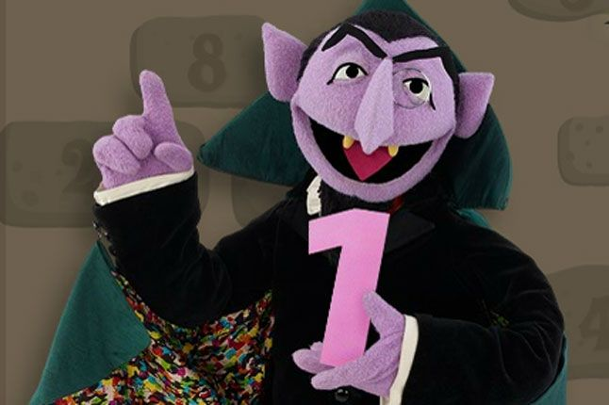
How many identities SHOULD you have?

Slide 8
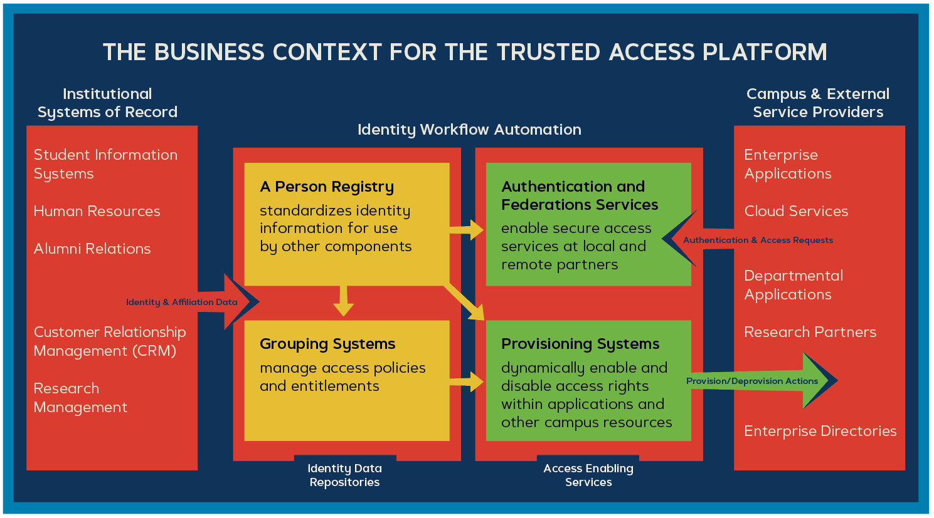

Slide 9
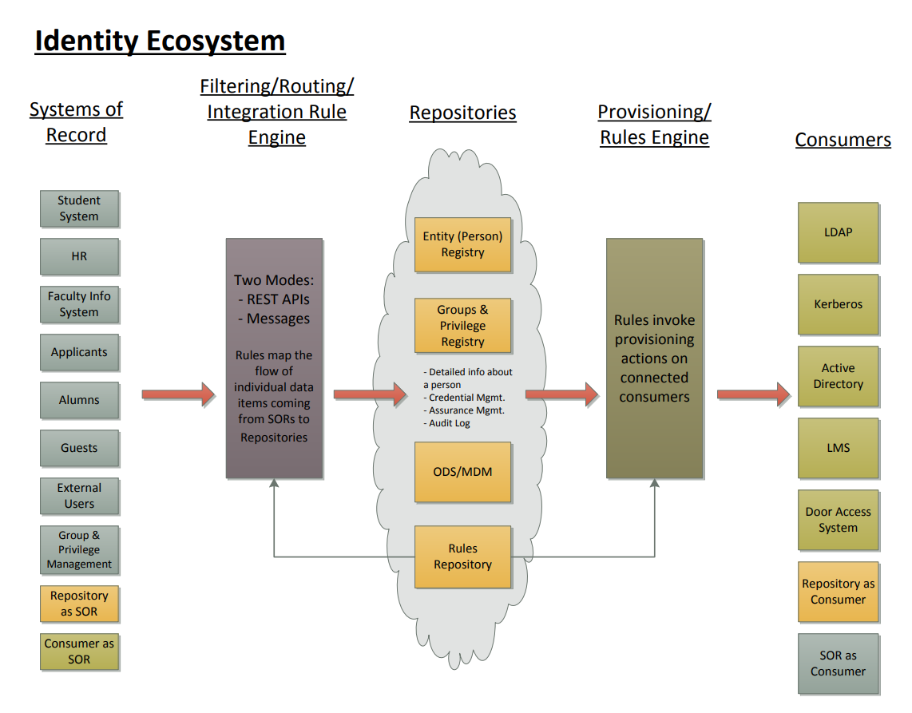

Slide 10
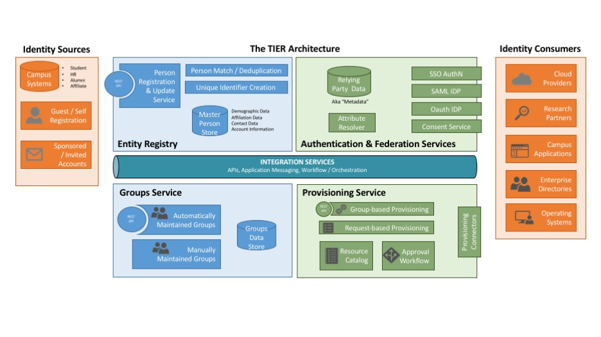
TIER Architecture – InCommon
(Trust and Identity in Education and Research (TIER)

Slide 11
Person Registry -- COmanage, midPoint
Authentication & Federation Services
WebSSO/SAML Identity Provider -- Shibboleth Identity Provider
Relying Party Information -- InCommon Metadata
Consent Service -- Scalable Consent
Groups Service -- Grouper
Provisioning Service -- COmanage, midPoint
Messaging & Queuing Service -- RabbitMQ
TIER Architecture – InCommon
(Trust and Identity in Education and Research (TIER)

Slide 12
What to Target
Size
Complexity

Slide 13
Birds of a Feather
Where are you on your journey?
What are you considering?
What have you experienced?
MidPoint
SailPoint
Savient
Duo

Slide 14
Links!
Slides
thedailydeveloper.com/ceug2025
Incommon TIER framework, Trusted Access Platform
incommon.org/trusted-access/
IAM Cuccio SIG – We Meet Monthly on Teams!
www.cuccio.net/sigs

Slide 15
WE ARE NOT ALONE!

